Slide 1
DNA and Computer Storage

Slide 2
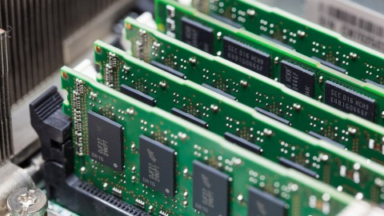
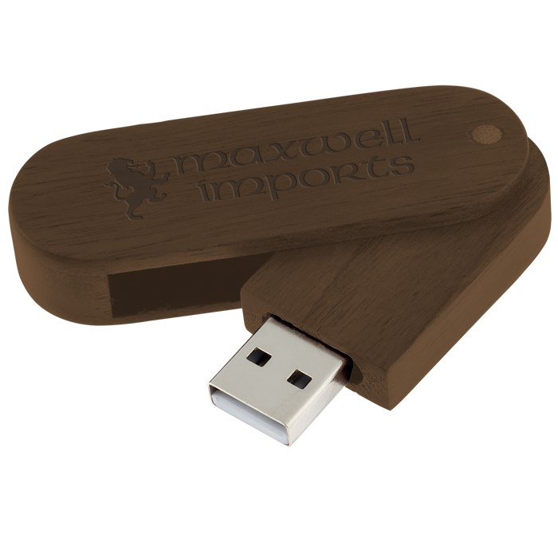
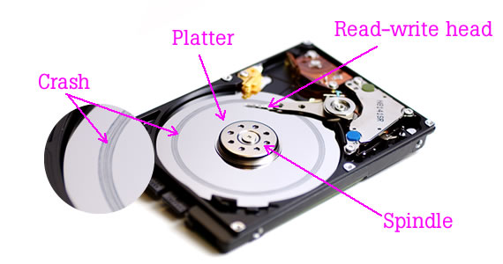
Where does your computer store memory?
Main Memory (RAM)
Memory that is remembered while the computer is powered on
Can be lost if the application closes before it is save to ROM
Consists of Random Access Memory and uses Ram sticks
Auxiliary Memory (ROM)
Memory that is remembered even if the computer is off
This can even include external storage such as USBs
It is called Read-Only Memory and mainly uses Hard Drives

Slide 3
How does your computer store data?
Your computer will store things in binary, converts everything into 0s and 1s
The 0s and 1s by itself is called a bit but put a string of 8 together and it becomes a byte
RAM
Temporary storage that allows you to interact with the application and save it to ROM
ROM
Storage that is not lost when an application/computer is shut down
Cannot be edited but your computer will read the data, including applications
Your computer would basically write over the data of the save

Slide 4
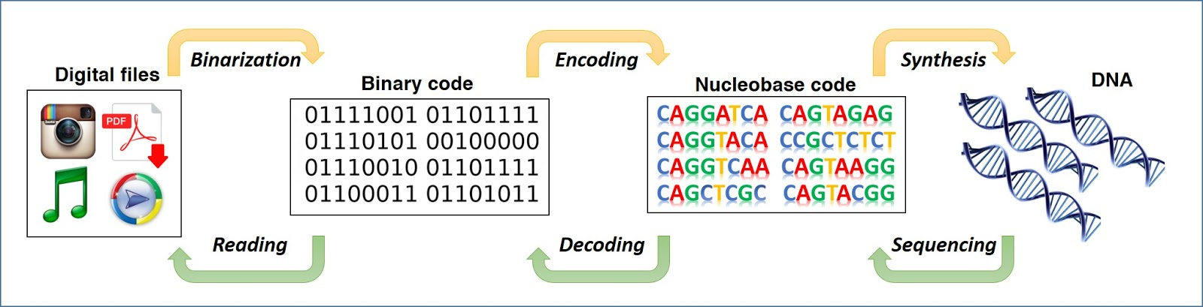
How does this relate to DNA?
As we went over in class, DNA is made up of Cytosine, Guanine, Adenine, and Thymine.
Adenine connects to Thymine and Guanine to Cytosine
If we think about this relationship between nucleobases we can start connecting these to 0s and 1s used to store memory

Slide 5
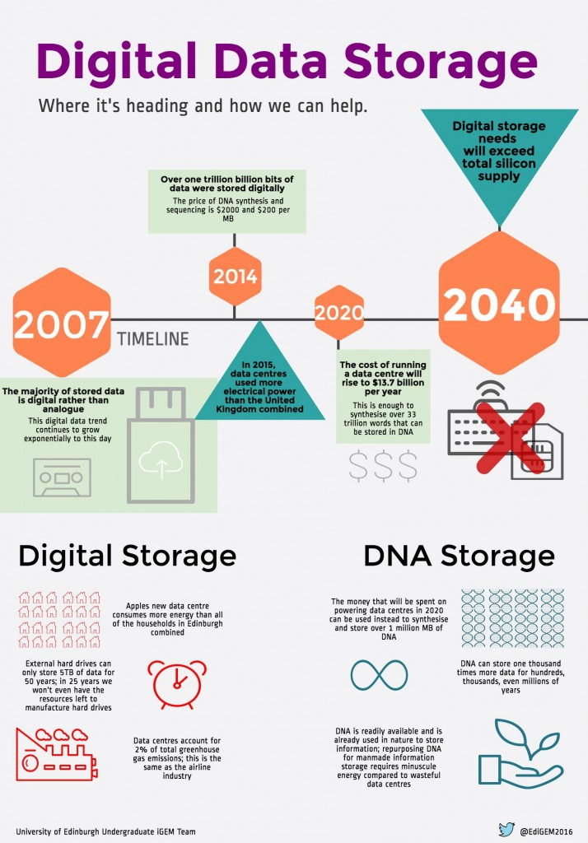
Where we are right now?
We have a method of storing 215 petabyte/g or a 215 million GB/g of DNA
It costs $7000 to write 2MB and $2000 to read
DNA can also last for thousands of years, if kept in the right conditions
We are currently looking to DNA as a way to solve a future data storage problem
Some are even looking into using DNA as RAM

Slide 6
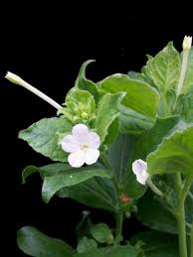
How does this relate to botany?
In 2013 two biotechnologists coded a basic “Hello World” program to Nicotiana benthamiana (close relative to tobacco)
The plant could reproduce and the code could be read back with 100% accuracy
Even the children would have the “Hello World” program
Using this as the basis, we could store some data using plants
The heavy maintenance of, naked, DNA based storage, today, could be harder in comparison to plant based storage
Unprotected against alteration and degradation
We would have backups in the form of seedlings
They stored the program with 100% accuracy

Slide 7
Possible future with Botany
You could be buying plants and seeds with programs at a technology store
Possible replacement for CDs
Programs become easy to manufacture
Less money used on manufacturing CDs and encoding them
More environmentally friendly
Cons
Harder to differentiate seeds and plants
Different programs or nothing could be in the same type of plant/seed
Everyday plants/seeds you find in your home could be mistaken as these modified plants
A need for organized labels that require a lot of attention to keep track of

Slide 8
Reasons for Botany
In terms of cost to get DNA, it may be considered cheaper to use plants
The initial cost of buying a plant and potting it, plus free seeds if the plant dies or if you want to grow more
It could be considered more ethical
Some people might take offense to animals being grown for this purpose or the possible abuse of animals that may be going on
Easier to raise
No need to worry, too much, about sickness and feeding

Slide 9
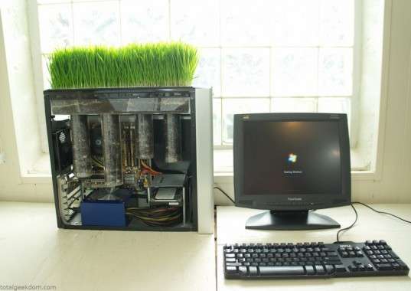
Science fiction/future ideas
The future ideas relating to botany is something like a genetically altered plant
The plant can somehow rearrange parts of its DNA and interact with computers
It could be used as an external storage device
There has been a DNA based CPU(Central Processing Unit; brain)
With this development, we could be looking at a possibility where computers become DNA based
Plants become computers
Smaller plants become laptops
Larger, bushier plants become computers
Tall plants like trees become servers

